Slide 1
Software Development with UML and Java 2
Threads Monitor

Slide 2
Setting up JavaFX in Java 11
IntelliJ: https://openjfx.io/openjfx-docs/#IDE-Intellij
Eclipse: https://openjfx.io/openjfx-docs/#IDE-Eclipse
Scene Builder
Version 10 for Java 11
Version 8 for Java 8

Slide 3
Questions about last time?

Slide 4
Agenda
Thread interference
Synchronized methods
Synchronized sections
Lock objects
Pausing a thread’s execution based on some condition

Slide 5
Thread interference
Sometimes two threads are manipulating a shared resource, and they end up counteracting each other
Exercise 3 from last time, about updating an integer

Slide 6
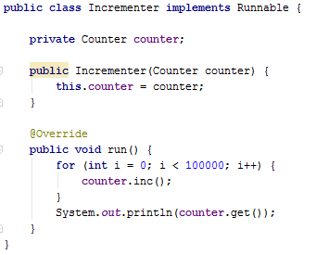
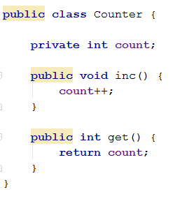
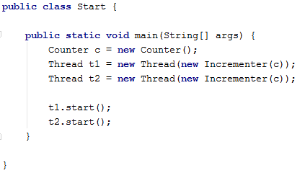
What did we observe?

Slide 7
What happened?

Slide 8
Easiest to explain with “Time slicing“
A thread executes a method.
Because of how the threads are given processor time, a thread may execute part of a method, then be put on hold, and later execute the rest.
While on hold, another thread may execute a couple of lines of code.
T1
T2

Slide 9
What went wrong here?
Is actually
count++;
Int c = count;
c = c + 1;
count = c;

Slide 10
T1
T2
count

Slide 11
T1
T2
int c = count;
c = c +1;
count = c;
count
int c = count;
c = c +1;
count = c;
// c = 3
// c = 3
// c = 4
// c = 4
// count = 4
// count = 4
We “lost” an increment

Slide 12


Slide 13
How do we fix this?
Synchronization
Methods
Statements

Slide 14
Locks
Each class instance has an intrinsic lock (monitor lock)
A thread can acquire the lock to block access for other threads.
This lock is acquired when a thread enters a synchronized method/section

Slide 15
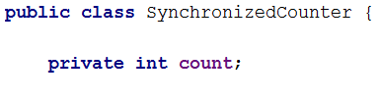



Synchronized method

Slide 16
Now, only one thread at a time can execute this method
Synchronized method
We synchronize all methods, which relate to the shared data

Slide 17
Synchronized method
Thread A enters the method, it acquires the lock. Thread A owns the lock.
If Thread B tries to enter the method, it is blocked/suspended until Thread A is done, at which point Thread A releases the lock, and Thread B can acquire it.

Slide 18
Running the example

Slide 19
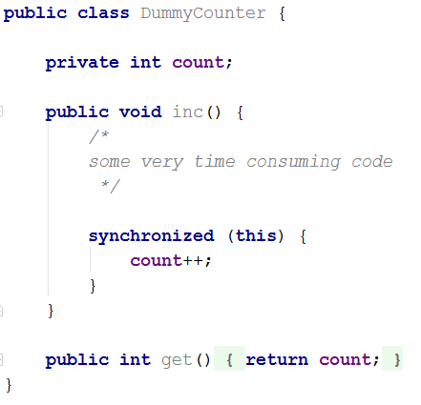
Synchronized blocks, another approach
We can synchronize parts of the code, instead of the entire method.
SynchronizedBlockCounter {
Will synchronize using the lock belonging to the instance of SynchronizedBlockCounter

Slide 20
Using synchronized blocks may be beneficial if only part of the method can cause problems.

Slide 21
We call the class SynchronizedBlockCounter:
Monitor → all methods are synchronized

Slide 22
Reentrant locking
When a synchronized method is called the lock of that object must be acquired.
What if that synchronized method calls another synchronized method?
Example →

Slide 23
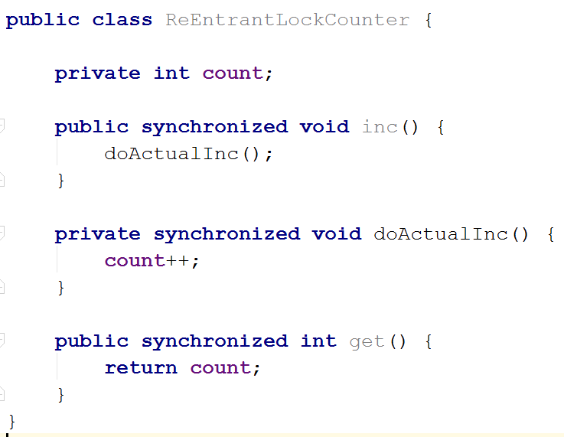
A thread calls the method inc, and acquires the lock of ReEntrantLockCounter

Slide 24
The method inc() then calls doActualInc()

Slide 25
This method is also synchronized, and so the lock must be acquired.

Slide 26
The thread calling inc() already owns the lock, so it doesn’t need to acquire it again from itself.

Slide 27
There was a question about this last semester, but it’s not a problem.

Slide 28


Slide 29
Lock objects

Slide 30
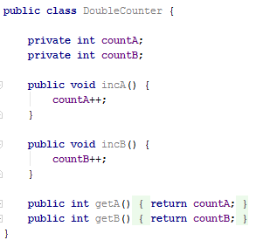
Multiple shared variables
Do we just synchronize everything?
Does it make sense that a thread working on countA, blocks a thread to work on countB?

Slide 31
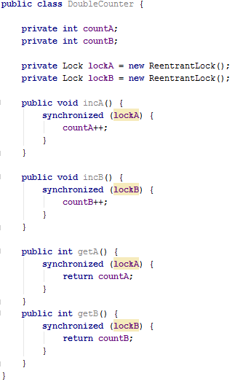
Lock Objects
Lock objects
Instead of locking, using the class’ own intrinsic lock, we’re now using another object.
We can now have multiple locks.

Slide 32
More about Lock objects.
One of the benefits of the lock objects is the tryLock method.
We’ll be using this in later Threads sessions, but introduce it today.
We’ll see that sometimes threads may wait indefinitely for obtaining a lock, and that will block the system.

Slide 33
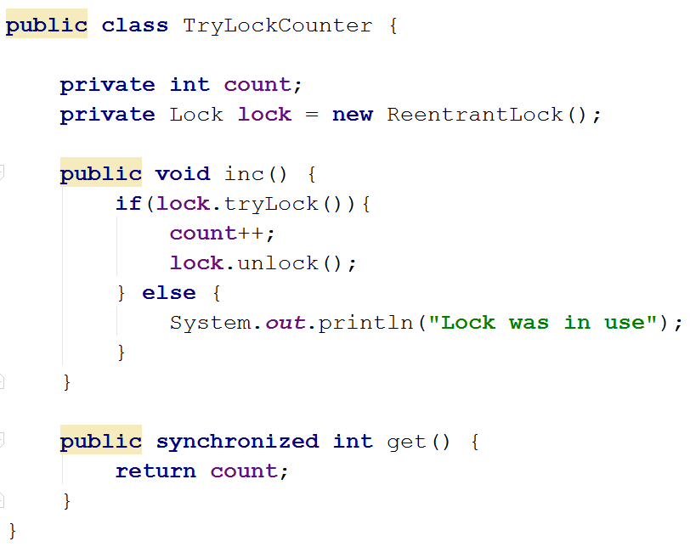
Only if the lock was obtained, do we proceed to increment count.
I could for example here wait a little while, and then try again,
if I cannot acquire the lock

Slide 34
Remember to manually unlock again!
I could for example here wait a little while, and then try again,
if I cannot acquire the lock

Slide 35


Slide 36
Multiple locks
Reentrant, explain stuff

Slide 37
Conditional Synchronization
A Thread wants to execute a synchronized method, but finds out that the current state of the object is not valid for the method execution.
It should wait until the state of the object is valid

Slide 38
Decrement and increment
int counter
Thread B
Decrement counter
Thread A
Increment counter
if (counter > -20)
if (counter < 20)

Slide 39
Wait and notify
A thread can call wait() to suspend itself
A thread can call notifyAll() to wake up waiting threads.
If more threads are waiting, then one of them will win the lock, the others will continue waiting.
We have no control over which threads acquires the lock

Slide 40
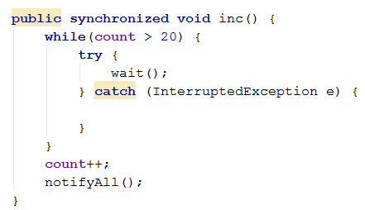
Notice the while-loop. Not an if-statement

Slide 41
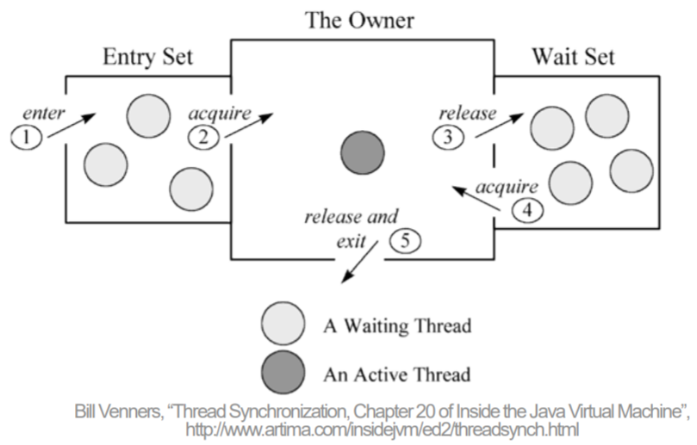
0. Thread A wants to call method
It’s waiting for the lock in the Entry Set
It acquires the lock, and becomes the Owner, and can execute the method.
If wait() is called, it’s put in the Wait Set
If wait() is not called, and the method is executed, A releases the lock, and notifies
When notifying, all waiting threads, both in Entry and Wait set, are woken and “fight” to acquire the lock

Slide 42


Slide 43
What have we learned today?
The concept of synchronization
It’s about one thread blocking access for other threads to avoid interference
We can synchronize entire methods
We can synchronize ”critical blocks”, i.e. important parts of methods
We can put a thread on hold using wait(), and ”unhold” it with the notifyAll call.

Slide 44


Slide 45

S

